Slide 1
Java
Reasoning About Code

Slide 2
Outline
Java
  Types and type checking, type safety
  Interpretation vs. compilation
Reasoning about code
Spring 18 CSCI 2600, K. Kuzmin, A Milanova

Slide 3
Java: Differences with C++
Model for variables
  Java uses reference model for class types
    No explicit pointers. All references are pointers
    Must explicitly create object: Foo f = new Foo();
    Two equalities: == and equals.
    Remember: when comparing strings, use equals!
Types and type checking, type safety
Interpretation vs. Compilation
Other: interfaces, inheritance, etc.
Spring 18 CSCI 2600, K. Kuzmin, A Milanova

Slide 4
Types and Type Checking, Type Safety
What is the role of types?
  Data abstraction
  Safety!
Types and type checking prevent the program from going wrong. Disallow operations on objects that do not support those operations
  E.g., a + b where a and b are 2DPoints is rejected by the type checker
  E.g., a.substring(0,10)where a is an int is rejected too

Slide 5
Type Safety
Type safety: no operation is ever applied on object of the wrong type (i.e., object that does not support that operation)
Java is type safe while C/C++ is type unsafe
  In Java, the type system never allows operations on objects of the wrong type (i.e., in no execution such erroneous operations occur)
  In C++, the type system prevents most errors, but it is possible to write a program where operation on object of the wrong type occurs
Goal: catch errors as early as possible!

Slide 6
Types and Type Checking
Java and C/C++ are statically typed
  Statically typed languages typically require type annotations; perform substantial amount of type checking before runtime
  Expressions have static (compile-time) types
  … and they have dynamic (run-time) types
Alternative is dynamically typed
  Perform substantial type checking during runtime
Spring 18 CSCI 2600, K. Kuzmin, A Milanova
Notes:
A statically typed languages associates types with expressions and performs substantial type checking before program execution.
The point of type checking is to catch as many “nonsensical” operations as possible and prevent them from happening at runtime.
Statically-typed languages do a lot of type checking at compile time.

Slide 7
C++ is Type Unsafe
// C++:
void* x = (void *) new A;
B* q = (B*) x; //a safe downcast?
int case1 = q->foo(1);//what happens?
// Java:
Object x = new A();
B q = (B) x; //a safe downcast?
int case1 = q.foo(1); //what happens?
Note: In Java, all methods are virtual;
use final keyword to force non-virtual
A
virtual foo()
B
virtual foo()
virtual foo(int)
Throws ClassCastException here!
Runtime never reaches bad call.
Spring 18 CSCI 2600, K. Kuzmin, A Milanova
Notes:
In C++ this is undefined behavior! The compiler may well generate code which calls foo(int) of B and apply foo(int) on a wrong type, type A. This is erroneous behavior that may or may not cause problems at runtime. It usually does cause problems!
The Java snippet compiles, but fails at runtime. The Java runtime system checks whether x holds a B (or a subtype of B). It does not, so it throws an exception. The point is, execution NEVER reaches q.foo(1), so foo(int) will never be applied on the wrong type.

Slide 8
C++ is Type Unsafe
Java: B q; … q.foo(1);
  Java “honors” its promise that at q.foo(1) if q is not null, q is a B (or subclass of B).
C++: B* q; … q->foo(1);
  C++ does not “honor” its promise. q can be a B or an A or a Duck or whatever
  This is because C++ is a superset of C
Spring 18 CSCI 2600, K. Kuzmin, A Milanova

Slide 9
Type Safety
Java ensures type safety with a combination of compile-time (static) and runtime (dynamic) type checking
  Compiler rejects plenty of programs. E.g., String s = 1 is rejected, String s = new Integer(1) is rejected
  Some checks are left for runtime. Why?
    E.g., at B b = (B) x; the Java runtime checks if x refers to a B, and throws an Exception if it doesn’t
Is Python type safe?
Spring 18 CSCI 2600, K. Kuzmin, A Milanova

Slide 10
Java Throws Lots of Exceptions!
E.g.:
ArrayIndexOutOfBounds at x[i]=0; if i is out of bounds for array x
ClassCastException at B q = (B) x; if the runtime type of x is not a B
NullPointerException at x.f = 0; if x is null
Spring 18 CSCI 2600, K. Kuzmin, A Milanova

Slide 11
Java Throws Lots of Exceptions
Exceptions are a good thing!
  Tell us what went wrong
  Prevent application of operation on wrong type – stop program from doing harm down the road
Object x = new A();
B q = (B) x; // ClassCastException
// because A is not a B
… int case1 = q.foo(1);
Exception prevents execution from reaching
q.foo(1) and applying foo(1) on an object
(A) that does not support foo(int)

Slide 12
Compilation vs. Interpretation
Compilation
  A “high-level” program is translated into executable machine code
  Compiler. C++ uses compilation
Pure interpretation
  A program is translated and executed one statement at a time
  Interpreter
Hybrid interpretation
  A program is “compiled” into intermediate code; intermediate code is “interpreted”
  Both a compiler and an interpreter. Java
Spring 18 CSCI 2600, K. Kuzmin, A Milanova

Slide 13
Compilation
COMPILER
character stream
Scanner (lexical analysis)
Machine-independent
code improvement
token stream
Parser (syntax analysis)
parse tree
modified
intermediate form
Semantic analysis and
intermediate code generation
Code Generation
target language
(assember)
abstract syntax tree
and intermediate form
Machine-dependent
code improvement
modified
target language
Spring 18 CSCI 2600, K. Kuzmin, A Milanova
Notes:
The compiler is a sequence of phases (passes) where the output
of each phase is the input to the next phase.
The Scanner takes as input a character stream (the program code)
and outputs a token stream. The Parser takes the token stream and
outputs a parse tree. The Semantic analysis and intermediate code
generation phase takes the parse tree and outputs the abstract
syntax tree or another intermediate form. And so on.
In our course, we will discuss in detail the Scanner, the Parser and
the Semantic Analysis.
Last, the left side of this picture, namely the Scanner, Parser,
Semantic analyzer and intermediate code generator form the
FRONT END (or machine-independent part) of the COMPILER.
The optimizer and code generator form the BACK END
(machine-dependent part) of the COMPILER.

Slide 14
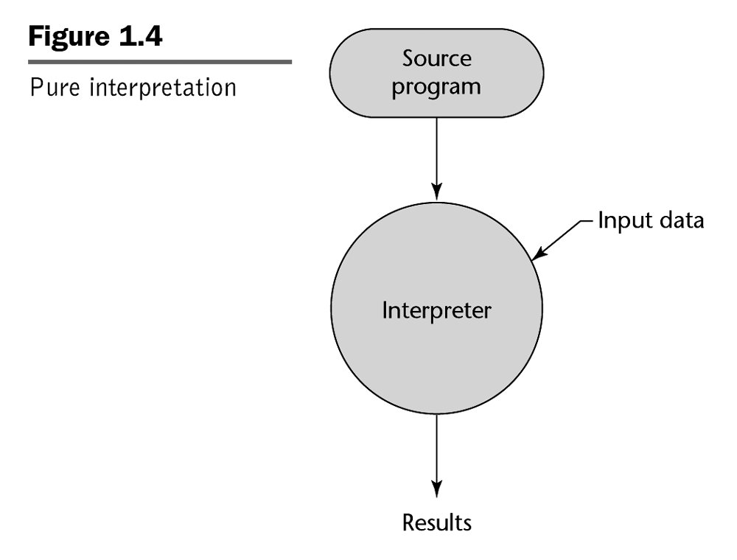
Pure Interpretation
e.g. BASIC
REM COMMENT
LET X = 5
LET Y = 8
PRINT X
PRINT Y
LET Z = X
PRINT Z
...
Spring 18 CSCI 2600, K. Kuzmin, A Milanova

Slide 15
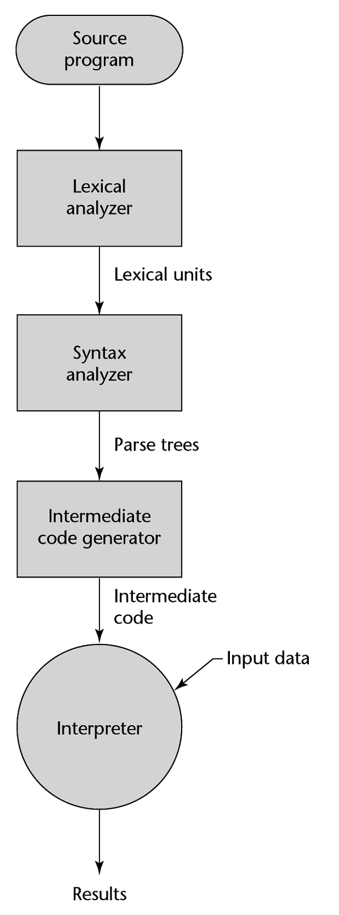
Hybrid Interpretation
09 AB 19 29 99 73 09 AB 19 29 99 73 09 AB 19 29 99 73 09 AB 19 29 99 73 09 AB 19 29 99 73 09
Compiler
e.g. Java byte code
e.g. Java Virtual Machine (JVM)
Also Perl....
Spring 18 CSCI 2600, K. Kuzmin, A Milanova
Notes:
Note that Lexical analyzer is another term (often used in texts) for Scanner.
Similarly, Syntax analyzer is another term for Parser.

Slide 16
Compiling and Running Java
Command line:
  javac HelloWorld.java produces HelloWorld.class
  java HelloWorld // runs the interpreter
Eclipse:
  Compiles automatically when you save!
  Run -> Run runs the interpreter
Spring 18 CSCI 2600, K. Kuzmin, A Milanova

Slide 17
Compilation vs. Interpretation
Advantages of compilation?
  Faster execution
Advantages of interpretation?
  Greater flexibility
    Portability, sandboxing, dynamic semantic (i.e., type) checks, other dynamic features are much easier
Spring 18 CSCI 2600, K. Kuzmin, A Milanova

Slide 18
Some Terminology
C++: Base class and derived class
Java: Superclass and subclass
C++: Member variable, member function
Java: field (instance or static), method (again instance or static)
Java has interfaces (collections of method signatures)
  Single class inheritance (class B extends A {…),
  Multiple interface inheritance (class A implements I,J,K {…)
  class B extends A implements I,J,K {…
Spring 18 CSCI 2600, K. Kuzmin, A Milanova
Notes:
I use the terms superclass and subclass.

Slide 19
Outline
Java
Intro to reasoning about code (informal account)
  Specifications
  Preconditions and postconditions
  Forward reasoning and backward reasoning
Spring 18 CSCI 2600, K. Kuzmin, A Milanova

Slide 20
Reasoning About Code
Determines what facts hold during program execution
0 <= index < names.length
x > 0
array names is sorted
x > y
x != 0
Spring 18 CSCI 2600, K. Kuzmin, A Milanova

Slide 21
Why Reason About Code
Remember, our goal is to produce correct code! Two ways to ensure correctness
  Testing
  Reasoning about code. Known as verification
Reasoning about code
  Verifies that code works correctly
  Finds errors in code
  Helps understand errors
    E.g., what input caused division by zero?
Spring 18 CSCI 2600, K. Kuzmin, A Milanova (based on slides by Michael Ernst, UW)

Slide 22
Specifications
What does it mean for code to be correct?
  (Informally) Code is correct if it conforms to its specification
A specification consists of a precondition and a postcondition
  Precondition: conditions that must hold before code executes
  Postcondition: conditions that must hold after code finishes execution (if precondition held!)
Spring 18 CSCI 2600, K. Kuzmin, A Milanova
Notes:
conditions: constraints on the values of variables

Slide 23
Specifications
Notation:
&& denotes logical AND
|| denotes logical OR
Precondition: arr.length = len && len > 0
Postcondition: result = arr[0]+…+arr[arr.length-1]
int sum(int[] arr, int len) {
int result = 0;
int i = 0;
while (i < len) {
result = result + arr[i];
i = i+1;
}
return result;
}
To prove that sum is correct, we must prove that the
implementation meets the specification. In other words,
we must prove that if the precondition held, when the
code finishes execution, the postcondition holds.
To do this, we must reason about code.
Spring 18 CSCI 2600, K. Kuzmin, A Milanova
Notes:
If len > arr.length, “sum” will bomb with an ArrayIndexOutOfBounds exception.
If len < 0 or len < arr.length, sum will terminate but compute incorrect result

Slide 24
Specifications
The specification is a contract between the function and its caller. Both caller and function have obligations:
  Caller must pass arguments that obey the precondition. If not, all bets are off – function can break or return wrong result!
  Function “promises” the postcondition
  In sum, how can the caller violate spec?
  How can sum violate spec?
Spring 18 CSCI 2600, K. Kuzmin, A Milanova

Slide 25
Aside: Type Signature is a Form of Specification
Type signature is a contract too!
E.g., int sum(int[] arr, int len) {…}
Precondition: arguments are an array of ints and an int
Postcondition: result is a int
Type signature is not enough! Why?
  We need reasoning about behavior and effects (deeper properties)
Spring 18 CSCI 2600, K. Kuzmin, A Milanova

Slide 26
Aside: Type Signature is a Specification
Type checker verifies that caller and callee obey the contract
If language is type safe we can “trust” the type checker
But if language is type unsafe it would be possible for a caller to pass an argument of the wrong type (or a callee to return a wrong type)
Spring 18 CSCI 2600, K. Kuzmin, A Milanova

Slide 27
Why Reason About Code
Ensure code works correctly
  Ensure that code meets the specification
  E.g., we can prove that sum is correct by proving that sum meets its specification
Find errors in code
Understand errors
Spring 18 CSCI 2600, K. Kuzmin, A Milanova

Slide 28
What is Wrong With this Code?
class NameList {
int index;
String[] names;
…
// Precondition: 0 ≤ index < names.length
// Postcondition: 0 ≤ index < names.length
void addName(String name) {
index++;
if (index < names.length)
names[index] = name;
}
}
Spring 18 CSCI 2600, K. Kuzmin, A Milanova (example modified from Michael Ernst)

Slide 29
What Inputs Cause Wrong Output?
String[] parseName(String name) {
int comma = name.indexOf(“,”);
String firstName = name.substring(0,comma);
String lastName = name.substring(comma+2);
return new String[] { lastName, firstName };
}
What input produces array [“Doe”,”Jane”]?
What input produces array [“oe”,”Jane”]?
What input would produce StringIndexOutOfBoundsException?
Spring 18 CSCI 2600, K. Kuzmin, A Milanova (example due to Michael Ernst)
Notes:
The programmer did not write a specification for this code. We know the expected output is [“Doe”,”John”]. But what must the caller do to produce this correct output? What is the condition on the input “name”?
name should be a String “FirstName, LastName” // A character string LastName, followed by comma, followed by space, followed by character string FirstName”

Slide 30
Types of Reasoning
Forward reasoning: given a precondition, what is the postcondition?
  Verify that code works correctly
Backward reasoning: given a postcondition, what is the precondition?
  Again, verify that code works correctly
  What input caused an error
Spring 18 CSCI 2600, K. Kuzmin, A Milanova (based on the slide by Michael Ernst)

Slide 31
Forward Reasoning
We know what is true before running the code. What is true after running the code?
// precondition: x is even
x = x + 3;
y = 2x;
x = 5;
// What is the postcondition here?
Spring 18 CSCI 2600, K. Kuzmin, A Milanova (based on slides by Michael Ernst)
Notes:
Assume all variables are Integers in examples.

Slide 32
Strongest Postcondition
Many postconditions hold from this precondition and code!
// precondition: x is even
x = x + 3;
y = 2x;
x = 5;
// postcondition: x = 5 && y % 4 = 2
// postcondition: x = 5 && y is even
// postcondition: x > 0 && y is even
x=5 && y%4 = 2 is the strongest postcondition.
It implies all other postconditions. More on stronger
and weaker conditions later.
Notes:
Strongest postcondition is the most specific postcondition. It gives most specific information about the behavior of the code.

Slide 33
Forward Reasoning Example
// precondition: x > y
z = x;
x = y;
y = z;
// What is the postcondition ??
Spring 18 CSCI 2600, K. Kuzmin, A Milanova
Notes:
The interesting postcondition: y > x.
We can derive many postconditions!
Postcondition: z = y AND y > x
Postcondition: x = y_o AND y = x_o AND x_o > y_o (Here x_o and y_o denote the starting values of x and y).
All of these imply the interesting postcondition: y > x.

Slide 34
Backward Reasoning
We know what we want to be true after running the code. What must be true beforehand to ensure that?
// precondition: ??
x = x + 3;
y = 2x;
x = 5;
// postcondition: y > x
Spring 18 CSCI 2600, K. Kuzmin, A Milanova (slide by Michael Ernst)
Notes:
2(x+3) > 5 equiv. to 2x > -1 equiv. x > -1/2
2x > 5
y > 5
y > x

Slide 35
Forward vs. Backward Reasoning
Forward reasoning is more intuitive, just simulates the code
  Introduces facts that may be irrelevant to the goal
  Takes longer to prove task or realize task is hopeless
Backward reasoning is usually more helpful
  Given a specific goal, shows what must hold beforehand in order to achieve this goal
  Given an error, gives input that exposes error
Spring 18 CSCI 2600, K. Kuzmin, A Milanova (based on slides by Michael Ernst)

Slide 36
Forward Reasoning: Putting Statements Together
Does the postcondition hold?
Precondition: x >= 0;
z = 0;
if (x != 0) {
z = x;
} else {
z = z+1
}
Postcondition: z > 0;
{ x >= 0 && z = 0 }
{ x > 0 && z = 0 }
{ x > 0 && z = x }
_x0016_
{ x = 0 && z = 0 }
{ x = 0 && z = 1 }
_x0016_
Therefore, postcondition holds!
Spring 18 CSCI 2600, K. Kuzmin, A Milanova (example due to Michael Ernst)

Slide 37
Forward Reasoning With a Loop
Does the postcondition hold?
Precondition: x >= 0;
i = x;
z = 0;
while (i != 0) {
z = z+1;
i = i-1;
}
Postcondition: x = z;
{ x >= 0 && i = x }
{ x >= 0 && i = x && z = 0 }
???
Yes, it holds. Key is to guess a
loop invariant. Then prove
by induction over the number
of iterations of the loop.
???
???
Spring 18 CSCI 2600, K. Kuzmin, A Milanova (based on the slide by Michael Ernst)
Notes:
Invariant: i + z = x

Slide 38
Next Time
Reasoning about code, more formally:
Hoare Logic
  Hoare Triples
  Rules for assignment, sequence, if-then-else
  Loops
Spring 18 CSCI 2600, K. Kuzmin, A Milanova
Notes:
Can we formalize (and mechanize) the process of reasoning?

